Slide 1
Using Apache Spark in Microsoft Fabric
Module 5

Slide 2
Introduction to Apache Spark
Worker Node
Executor
Cache
Task
Task
Driver Program
Cluster Manager
SparkContext
Worker Node
Executor
Cache
Task
Task
Notes:
Apache Spark is a distributed data processing framework that enables large-scale data analytics by coordinating work across multiple processing nodes in a cluster. Put more simply, Spark uses a "divide and conquer" approach to processing large volumes of data quickly by distributing the work across multiple computers. The process of distributing tasks and collating results is handled for you by Spark. You submit a data processing job in the form of some code that initiates a driver program, which uses a cluster management object called the SparkContext to manage the distribution of processing in the Spark cluster. In most cases, these details are abstracted - you just need to write the code required to perform the data operations you need.
An Apache Spark pool instance consists of one head node and worker nodes, could start a minimum of one node in a Spark instance. The head node runs extra management services such as Livy, Yarn Resource Manager, Zookeeper, and the Spark driver. All nodes run services such as Node Agent and Yarn Node Manager. All worker nodes run the Spark Executor service.
Spark can run code written in a wide range of languages, including Java, Scala (a Java-based scripting language), Spark R, Spark SQL, and PySpark (a Spark-specific variant of Python). Most data engineering and analytics workloads are accomplished using a combination of PySpark and Spark SQL.

Slide 3
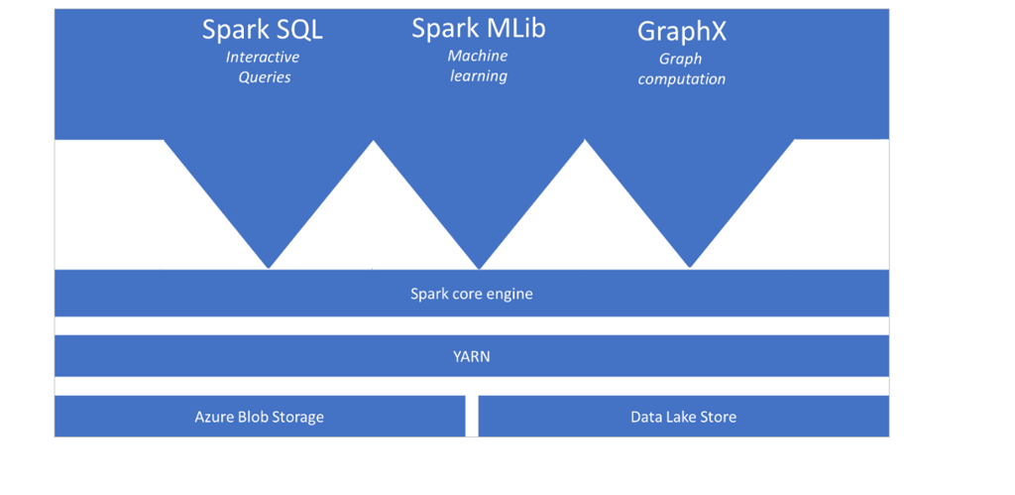
Introduction to Apache Spark
Notes:
On top of the distributed execution engine, you can have different functionalities that can interact with the Spark core engine that you will add as required. Examples include Spark SQL for interactive queries, Spark Mlib for machine learning and GraphX for graph computations. This enables you to set up diverse workloads on a single platform.
​

Slide 4
Spark in Fabric
Configurable Clusters
Notebooks that support Java, Scala, Python, and R
Built-in Delta Lake packages
Spark Job Definitions
Notes:
The Microsoft Fabric Runtime is an Azure-integrated platform based on Apache Spark that enables the execution and management of data engineering and data science experiences. It combines key components from both internal and open-source sources, providing customers with a comprehensive solution. For simplicity, we refer to the Microsoft Fabric Runtime powered by Apache Spark as Fabric Runtime.
Major components of the Fabric Runtime:
Apache Spark - a powerful open-source distributed computing library, to enable large-scale data processing and analytics tasks. Apache Spark provides a versatile and high-performance platform for data engineering and data science experiences.
Delta Lake - an open-source storage layer that brings ACID transactions and other data reliability features to Apache Spark. Integrated within the Microsoft Fabric Runtime, Delta Lake enhances the data processing capabilities and ensures data consistency across multiple concurrent operations.
Default-level Packages for Java/Scala, Python, and R to support diverse programming languages and environments. These packages are automatically installed and configured, allowing developers to apply their preferred programming languages for data processing tasks.
The Microsoft Fabric Runtime is built upon a robust open-source operating system (Ubuntu), ensuring compatibility with various hardware configurations and system requirements.

Slide 5
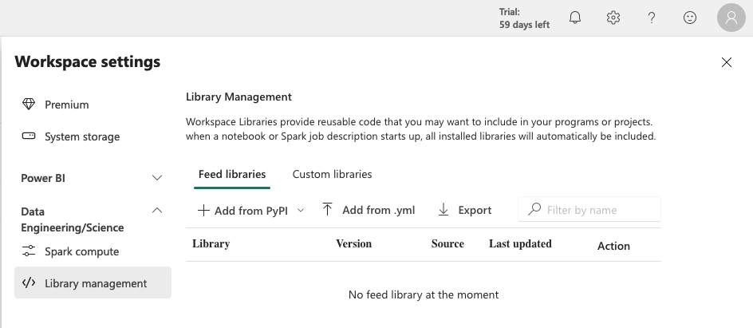
Spark Clusters in Fabric
Each workspace is assigned a cluster.
A workspace admin can change the type of virtual machines used, the Spark runtime version, and other Spark properties.
Clusters include many of the most commonly used libraries, but you can install others in the workspace settings
Notes:
When you create a workspace in Microsoft Fabric, a starter pool that is associated with that workspace is automatically created. With the simplified setup in Microsoft Fabric, there's no need to choose the node or machine sizes, as these options are handled for you behind the scenes. This configuration provides a faster (5-10 seconds) Spark session start experience for users to get started and run your Spark jobs in many common scenarios without having to worry about setting up the compute. For advanced scenarios with specific compute requirements, users can create a custom Spark pool and size the nodes based on their performance needs.
You can use these Spark VCores to create nodes of different sizes for your custom Spark pool, as long as the total number of Spark VCores doesn't exceed 128.
The size and number of nodes you can have in your custom Spark pool depends on your Microsoft Fabric capacity.
The Spark open source ecosystem includes a wide selection of code libraries for common (and sometimes very specialized) tasks. Since a great deal of Spark processing is performed using PySpark, the huge range of Python libraries ensures that whatever the task you need to perform, there's probably a library to help.
By default, Spark clusters in Microsoft Fabric include many of the most commonly used libraries, but if you need to install other libraries, you can do so on the Library management page in the workspace settings.

Slide 6
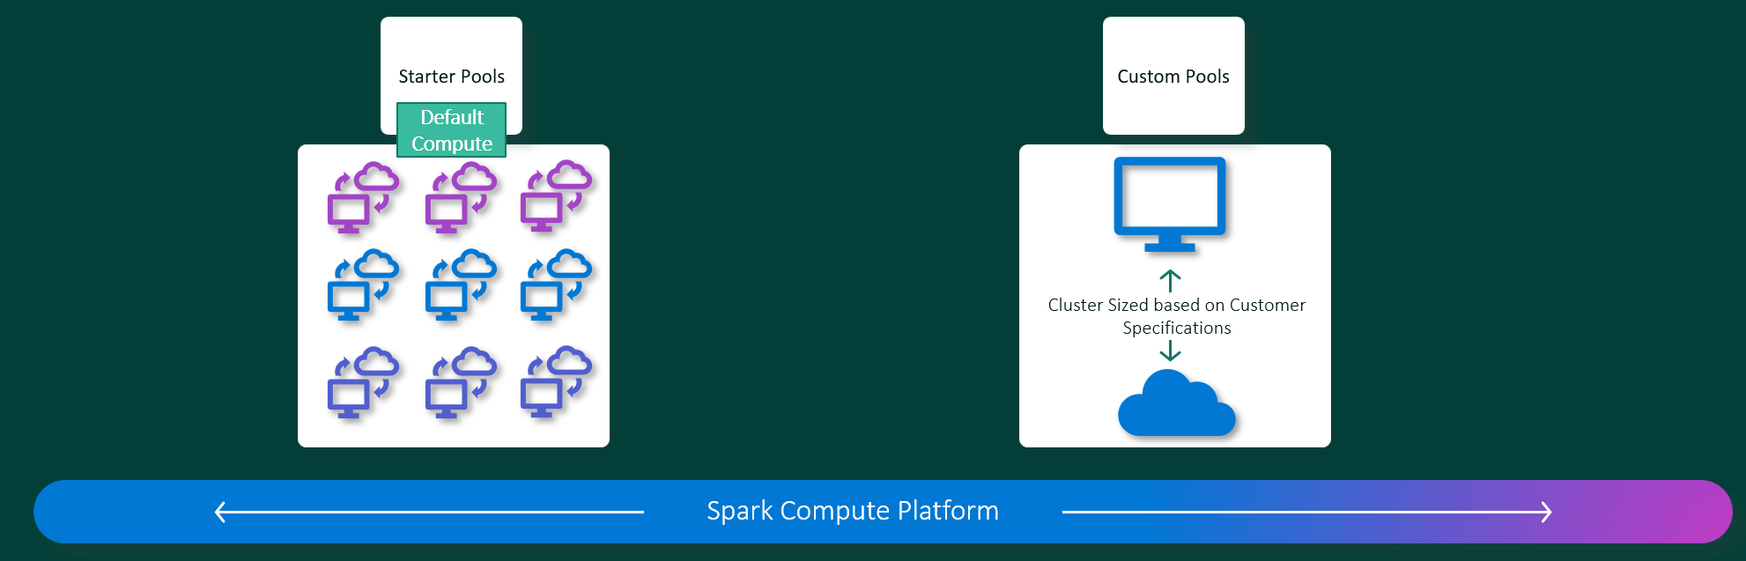
Spark Pools in Fabric
Notes:
Starter pools are a fast and easy way to use Spark on the Microsoft Fabric platform within seconds. You can use Spark sessions right away, instead of waiting for Spark to set up the nodes for you, which helps you do more with data and get insights quicker.
Starter pools have Spark clusters that are always on and ready for your requests. They use medium nodes that dynamically scale up based on your Spark job needs.
When starter pools, do not meet your needs, you can create custom pools.
With Custom Pools, users specify the minimum and maximum nodes for autoscaling. Based on those values, the system dynamically acquires and retires nodes as the job's compute requirements change, which results in efficient scaling and improved performance. Furthermore, the dynamic allocation of executors in Spark pools alleviates the need for manual executor configuration. Instead, the system adjusts the number of executors depending on the data volume and job-level compute needs. This process enables you to focus on your workloads without worrying about performance optimization and resource management.
These custom pools have a default autopause duration of 2 minutes. Once the autopause duration is reached, the session expires and the clusters are unallocated. You're charged based on the number of nodes and the duration for which the custom Spark pools are used.

Slide 7
Spark Pool Node Sizes
A Spark pool can be defined with node sizes that range from a small compute node (with 4 vCore and 32 GB of memory) to a large compute node (with 64 vCore and 512 GB of memory per node).
Size | vCore | Memory
Small | 4 | 32 GB
Medium | 8 | 64 GB
Large | 16 | 128 GB
X-Large | 32 | 256 GB
XX-Large | 64 | 512 GB
Notes:
A Spark pool can be defined with node sizes that range from a small compute node (with 4 vCore and 32 GB of memory) to a large compute node (with 64 vCore and 512 GB of memory per node). Node sizes can be altered after pool creation, although the active session would have to be restarted.

Slide 8
Autoscale for Spark Pools
Allows automation of scale up and down of compute resources based on activity
You specify the minimum and maximum number of nodes
You can change these settings, but you may need restart your instance
Notes:
Autoscale
Autoscale for Apache Spark pools allows automatic scale up and down of compute resources based on the amount of activity. When the autoscale feature is enabled, you set the minimum, and maximum number of nodes to scale. When the autoscale feature is disabled, the number of nodes set remains fixed. This setting can be altered after pool creation, although the instance may need to be restarted.
Dynamic allocation
Dynamic allocation allows the Spark application to request more executors if the tasks exceed the load that current executors can bear. It also releases the executors when the jobs are completed and if the Spark application is moving to idle state. Enterprise users often find it hard to tune the executor configurations because they're vastly different across different stages of a Spark Job execution process. These configurations are also dependent on the volume of data processed, which changes from time to time. Users can enable dynamic allocation of executors option as part of the pool configuration, which would enable automatic allocation of executors to the Spark application based on the nodes available in the Spark pool.

Slide 9
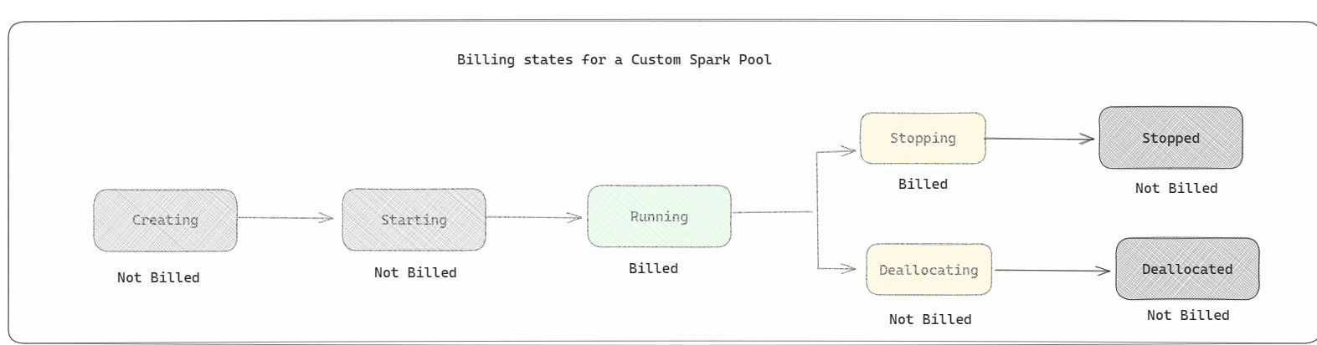
Spark Pools and Fabric Billing
Notes:
A Spark pool is a way of telling Spark what kind of resources you need for your data analysis tasks. You can give your Spark pool a name, and choose how many and how large the nodes (the machines that do the work) are. You can also tell Spark how to adjust the number of nodes depending on how much work you have. Creating a Spark pool is free; you only pay when you run a Spark job on the pool, and then Spark sets up the nodes for you.
If you don't use your Spark pool for 2 minutes after your session expires, your spark pool will be deallocated. This default session expiration time period is set to 20 minutes, and you can change it if you want. If you're a workspace admin, you can also create custom Spark pools for your workspace, and make them the default option for other users. This way, you can save time and avoid setting up a new Spark pool every time you run a notebook or a Spark job. Custom Spark pools take about three minutes to start, because Spark has to get the nodes from Azure.
You can even create Single Node Spark Pools, by setting the min number of nodes to 1, in which case the driver and executor would run in a single node which comes with restorable HA and is suited for small workloads.
The size and number of nodes you can have in your custom Spark pool depends on your Microsoft Fabric capacity. Capacity is a measure of how much computing power you can use in Azure. One way to think of it is that two Spark VCores (a unit of computing power for Spark) equals one capacity unit. For example, a Fabric capacity SKU F64 has 64 capacity units, which is equivalent to 128 Spark VCores. You can use these Spark VCores to create nodes of different sizes for your custom Spark pool, as long as the total number of Spark VCores doesn't exceed 128.

Slide 10
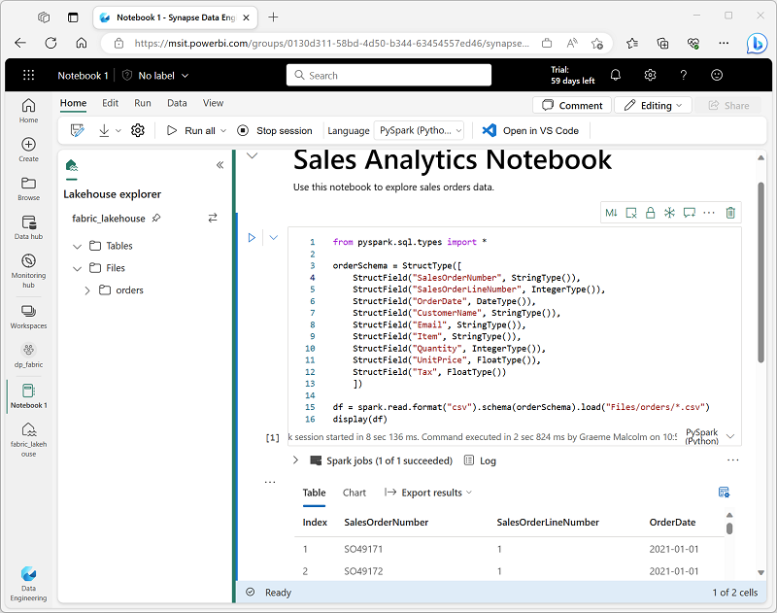
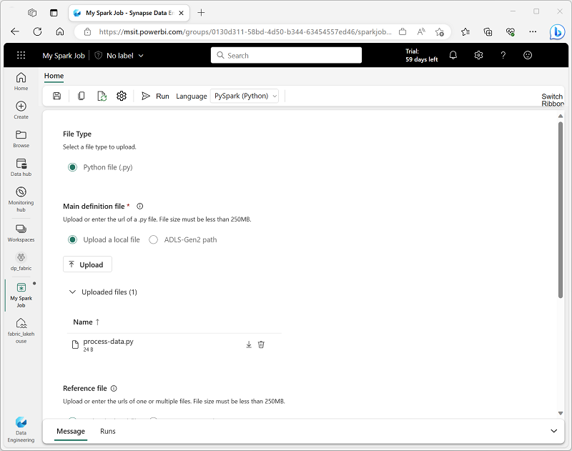
Running Spark Jobs
There are two methods for running Spark jobs in Fabric:
Jupyter notebooks
Spark jobs definition
Notebooks are commonly used to analyze and visualize data
Jobs are typically used for automated data processing
Notes:
Notebooks
When you want to use Spark to explore and analyze data interactively, use a notebook. Notebooks enable you to combine text, images, and code written in multiple languages to create an interactive artifact that you can share with others and collaborate.
Notebooks consist of one or more cells, each of which can contain markdown-formatted content or executable code. You can run the code interactively in the notebook and see the results immediately.
Spark job definition
If you want to use Spark to ingest and transform data as part of an automated process, you can define a Spark job to run a script on-demand or based on a schedule.

Slide 11
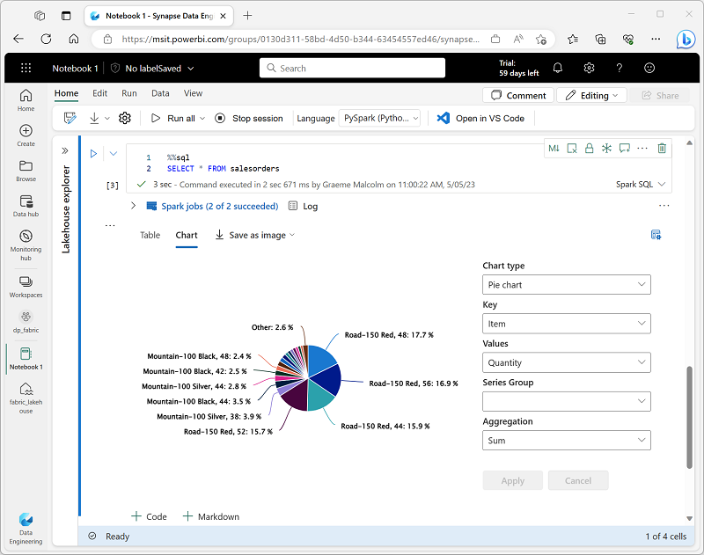
Working with data in a Spark Notebook
Notebooks enable you to combine text, images, and code written in multiple languages
Create an interactive artifact that you can share with others and collaborate
Use the build-in notebook charts or graphics packages in code to visualize data
Notes:
When you want to use Spark to explore and analyze data interactively, use a notebook. Notebooks enable you to combine text, images, and code written in multiple languages to create an interactive artifact that you can share with others and collaborate.
Notebooks consist of one or more cells, each of which can contain markdown-formatted content or executable code. You can run the code interactively in the notebook and see the results immediately.
The Dataframe API is part of a Spark library named Spark SQL, which enables data analysts to use SQL expressions to query and manipulate data.
Creating database objects in the Spark catalog
The Spark catalog is a metastore for relational data objects such as views and tables. The Spark runtime can use the catalog to seamlessly integrate code written in any Spark-supported language with SQL expressions that may be more natural to some data analysts or developers.
One of the most intuitive ways to analyze the results of data queries is to visualize them as charts. Notebooks in Microsoft Fabric provide some basic charting capabilities in the user interface, and when that functionality doesn't provide what you need, you can use one of the many Python graphics libraries to create and display data visualizations in the notebook.
Using built-in notebook charts
When you display a dataframe or run a SQL query in a Spark notebook, the results are displayed under the code cell. By default, results are rendered as a table, but you can also change the results view to a chart and use the chart properties to customize how the chart visualizes the data, as shown here:

Slide 12
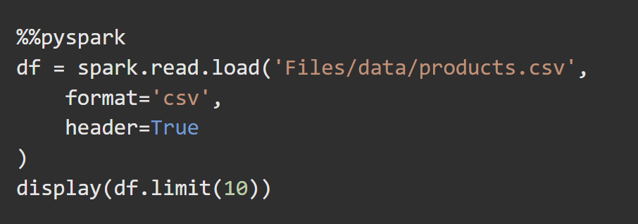
Spark Dataframes
%% magic commands
Inferred or explicit schema
Filter, sort, or group
Save to file
Partition output files
Notes:
Natively, Spark uses a data structure called a resilient distributed dataset (RDD); but while you can write code that works directly with RDDs, the most commonly used data structure for working with structured data in Spark is the dataframe, which is provided as part of the Spark SQL library. Dataframes in Spark are similar to those in the ubiquitous Pandas Python library, but optimized to work in Spark's distributed processing environment.
The %%pyspark line at the beginning is called a magic, and tells Spark that the language used in this cell is PySpark. You can select the language you want to use as a default in the toolbar of the Notebook interface, and then use a magic to override that choice for a specific cell.
Spark is able to infer the data type of each column from the data it contains. You can also specify an explicit schema for the data, which is useful when the column names aren't included in the data file.
You can use the methods of the Dataframe class to filter, sort, group, and otherwise manipulate the data it contains.
You can "chain" methods together to perform a series of manipulations that results in a transformed dataframe.
To group and aggregate data, you can use the groupBy method and aggregate functions.
You'll often want to use Spark to transform raw data and save the results for further analysis or downstream processing.
Partitioning is an optimization technique that enables Spark to maximize performance across the worker nodes. More performance gains can be achieved when filtering data in queries by eliminating unnecessary disk IO.
To save a dataframe as a partitioned set of files, use the partitionBy method when writing the data.

Slide 13
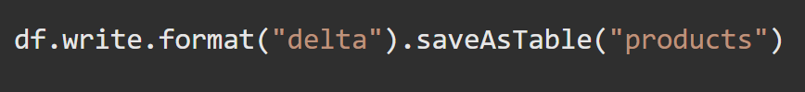
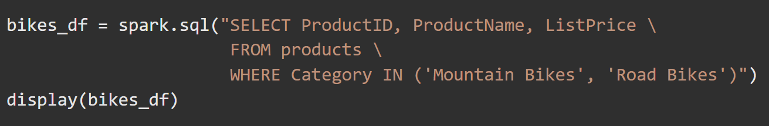
Working with Spark SQL
Execute SQL queries
%%sql magic command
Managed tables or external tables
Notes:
The Dataframe API is part of a Spark library named Spark SQL, which enables data analysts to use SQL expressions to query and manipulate data.
The Spark catalog is a metastore for relational data objects such as views and tables. The Spark runtime can use the catalog to seamlessly integrate code written in any Spark-supported language with SQL expressions that may be more natural to some data analysts or developers.
A view is temporary, meaning that it's automatically deleted at the end of the current session. You can also create tables that are persisted in the catalog to define a database that can be queried using Spark SQL.
Tables are metadata structures that store their underlying data in the storage location associated with the catalog. In Microsoft Fabric, data for managed tables is stored in the Tables storage location shown in your data lake, and any tables created using Spark are listed there.
You can create an empty table by using the spark.catalog.createTable method, or you can save a dataframe as a table by using its saveAsTable method. Deleting a managed table also deletes its underlying data.
Additionally, you can create external tables by using the spark.catalog.createExternalTable method. External tables define metadata in the catalog but get their underlying data from an external storage location; typically a folder in the Files storage area of a lakehouse. Deleting an external table doesn't delete the underlying data.
You can use the Spark SQL API in code written in any language to query data in the catalog.

Slide 14
Summary
Spark is a very popular tool for a variety of data science and data engineering tasks
Fabric offers default and configurable Spark clusters for each workspace
Spark commands can be executed in a job definition or a notebook
Notebooks offer support for multiple languages
Spark SQL, and specifically dataframes, are commonly used to query and manipulate data

Slide 15

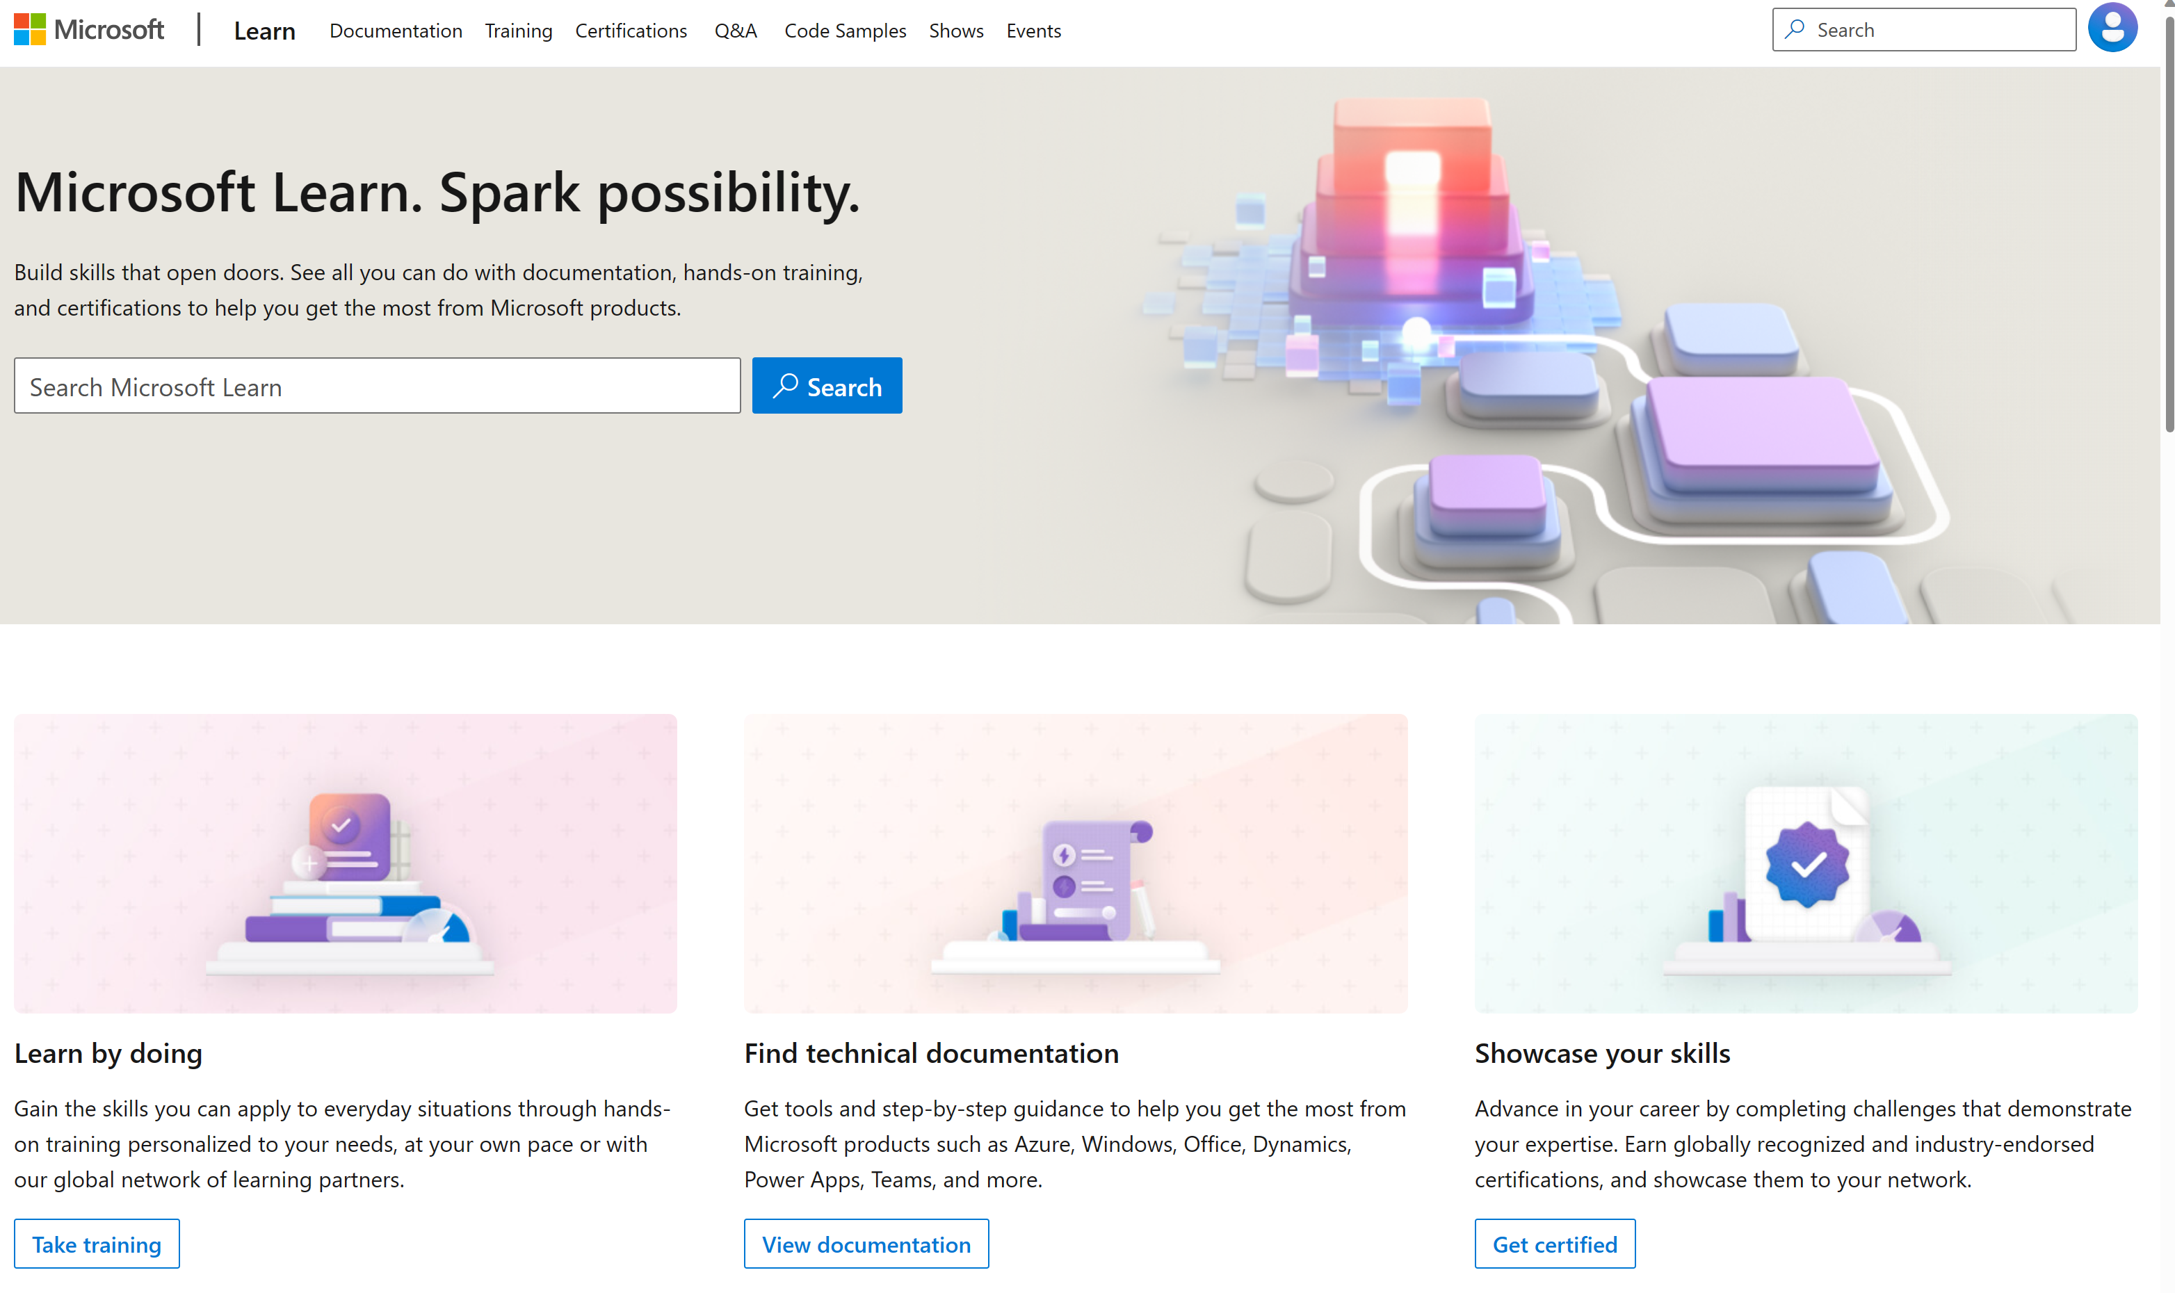
Microsoft Learn Demo
Microsoft Learn: Build skills that open doors in your career

Slide 16
Readiness and Enablement Links
The Microsoft Federal Team is here to help you accelerate customers' digital transformation. Microsoft Federal has tailored to make your organizations skilling journey successful. From the Business Decision Maker to the technical community and end-users, Microsoft provides customers with access to endless skilling resources. Below you will find links to these resources:
Get training tailored to your organization's needs: Find learning paths for specific roles in your organization, plus course recommendations based on technology, skill level, and solution area: Training | Learning Portal (microsoft.com)
Events Calendar - US Partner Community Blog – Microsoft
In addition to the above, the Microsoft Federal Team can address the needs of your non-technical community of your learners through:
Skilling Hours - Readiness and Enablement: Skilling our Federal Customers and Partners (office.com)
Microsoft Learning Portal: A closer look at Azure through training modules and gamified learning
Microsoft Learning Portal
Additional Learning Resources:
Get started with Azure – Introduction | Microsoft Azure
Microsoft Learn (path-based)
Exam-based: Select filters: Azure, D365, M365, Power Platform, and more
Microsoft Virtual Training Days – Virtual Instructor Led
Microsoft Technology Center - Work through your Account Manager
Home - Microsoft Tech Community
Microsoft Reactor | Microsoft Developer – Virtual Instructor Led

